Slide 1
AS ONE LISTENS TO THE RAIN
Souvik Mukherjee
1740825
Tripti Agarwal
1740865
OCTAVIO PAZ

Slide 2
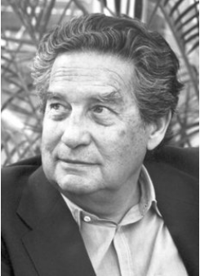
THE POET
Octavio Paz was born in 1914 in Mexico City. Thanks to his grandfather’s extensive library, Paz began to write at an early age and in 1938, he became one of the founders of the journal, Taller. He was then a part of the Guggenheim Fellowship where he completely immersed himself in Anglo-American Modernist poetry.
In 1962, having entered the Mexican diplomatic service, Paz was appointed Mexican ambassador to India: an important moment in his life and work, as witnessed in books like The Grammarian Monkey and East Slope, that were written during his stay there.
Notes:
Taller- Spanish for workshop
Prize- intl. literary prize often compared with nobel prize in literature

Slide 3
Paz is a poet and an essayist. He believes that poetry constitutes “the secret religion of the modern age.” One aspect of Paz’s work is his tendency to maintain elements of prose in his poetry, and poetic elements in his prose.
He was awarded the Nobel Prize in 1990 "for impassioned writing with wide horizons, characterized by sensuous intelligence and humanistic integrity”.
Paz’s literary career helped to define modern poetry and the Mexican personality and his death was mourned as the end of an era for Mexico.

Slide 4
About the poem
The poem is in free verse, i.e., it does not follow regular rhyme scheme rules, and yet provides artistic expression.
The poet has not split the poem into stanzas giving us the feeling that this was a constant flow of ideas resonating from the emotions in each line.

Slide 5
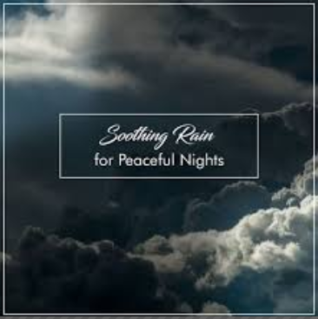
Tone of the poem
The tone of the poem is very peaceful. It is calming and serene in feeling. It relaxes the reader, while the speaker describes his view of nature.

Slide 6
Theme
The theme of this poem is that you have to notice the little things. The little details could be the most beautiful details.
Another theme is that nature could easily be overlooked, but when you pay attention, nature will provide you with the most beautiful memories.
One theme could be that you need to cherish the beautiful things you see.
One must be able to share that beauty with other people.

Slide 7
About the Speaker
The speaker of the poem is someone who is very observant of nature.
The speaker has a high admiration for nature, and describes in great detail throughout the poem.
The speaker is talking to someone that has a close relationship with the speaker, like a friend for example.
He speaks in the first person as if he was talking to another person.
The story of the poem is the speaker describing beautiful things in nature to another person.
He uses imagery so the person can visualize the things that he saw in nature.

Slide 8
Analysis
The poet starts with the speaker trying to get the attention of the listener, he doesn’t demand complete attention. All he wants is to not be ignored.
Uncertainty, the elements of nature described implies that the speaker is in uncertain if the other person is actually listening.
The speaker wants the person to introspect and actually hear and not only listen to him. It is clear by this that the speaker was really longing for a loved one.
The speaker is not content as he says “weightless time and heavy sorrow”. It shows that he is feeling bad for a loved one

Slide 9
Analysis
The speaker speaks about a person he really loves and wished was there as he compares that person to steam by saying “steam rises and walks away”
“you are you and body of steam” by this line the speaker is probably referring to a loved one who may not be present but he acknowledges the existence of the person with a lot of emotions and feelings.
“you cross the street and enter my forehead”, the speaker is referring to the fact that even when the person leaves, his mind is filled with thoughts about that person.
“your fingers of water dampen my forehead” shows how close they are and that they were extremely comfortable with each other.

Slide 10
LITERARY DEVICES Anaphora
The deliberate repetition of the first part of the sentence in order to achieve an artistic effect.
“it is the mist, wandering in the night, it is the night, asleep in your bed, it is the surge of waves in your breath”
“you and your body of steam, you and your face of night, you and your hair”
Notes:
Anaphora- grab attention

Slide 11
Oxymoron
They imply the use of contradictory and contrasting concepts in a manner that actually ends up making sense in a strange, and slightly complex manner.
“without listening, hear what I say with eyes open inward, asleep with all five senses awake”
Notes:
Keeps the reader hooked
Helps to explore different layers of semantics while writing.

Slide 12
Imagery
It refers to the usage of words and phrases to create “mental images” for the reader. It is not only limited to visual sensations, but also ignites kinesthetic, olfactory, and auditory sensations.
“wet asphalt is shining, steam rises and walks away”
“listen to the rain running over the terrace”
“lightning has nestled among the leaves”
Notes:
- Describes and creates image of rain hitting the asphalt
- Helps to conjure an image while actually referring to a sound

Slide 13
Personification
It is the practice of attaching human traits and characteristics with inanimate objects and phenomena.
“it's raining, light footsteps, a murmur of syllables”
“steam rises and walks away, night unfolds and looks at me”
“the day is still leaving,
the night has yet to arrive.”
“water that is air, air that is time, the day is still leaving,
the night has yet to arrive,
figurations of mist
at the turn of the corner”
(refers to mist and dusk)
Notes:
Makes the readers think and gives more details so as to help paint a picture in their minds

Slide 14
Conclusion
The person is compared to various elements throughout the poem, which shows that the person might not even be present, but her presence is felt by the speaker.
Her presence for the speaker was eternal just like nature.
Readers can envision the memories of the speaker and experience the beauty of nature along with him.
It makes the reader realise how it is important to cherish the beautiful things around them, before they are gone.
Notes:
His love is as natural as nature.

